Slide 1
Opportunities

Slide 2
Two colleagues went out hunting. One was the father of the other one’s son. How is this possible?
A man and a woman are quietly reading together. The woman gets up and turns out the light. The man continues to read. How is this possible?

Slide 3
To celebrate her tenth birthday Anne drove a nail into the trunk of an oak tree. Assuming that the tree grew three inches each year, how much higher would the nail be when Anne is 25 years old?
If it’s not the day after Monday or the day before Thursday, and it isn’t Sunday tomorrow nor was it Sunday yesterday, and the day after tomorrow isn’t Saturday, and the day before yesterday wasn’t Wednesday, what day is it, according to the description?

Slide 4
Answer all Question Read all questions carefully before you attempt to answer
Write your name at the upper right side of your paper
Write your address and telephone number under your name
Underline the name in question one
Draw three triangles under your name
What is 500/5
Circle the three of the boxes
What is the opposite of boy
Who is the Vice President of Ghana
In the absence of the Vice President and the President, who can act as president in Ghana
What is the full meaning of MMDAs
What is a grant
Now that you have read through everything, only answer questions 1 &2

Slide 5

The Nature of Business Opportunity

Slide 6
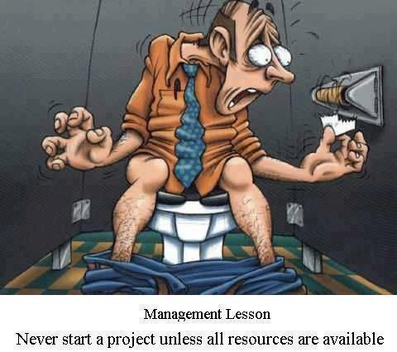

Slide 7
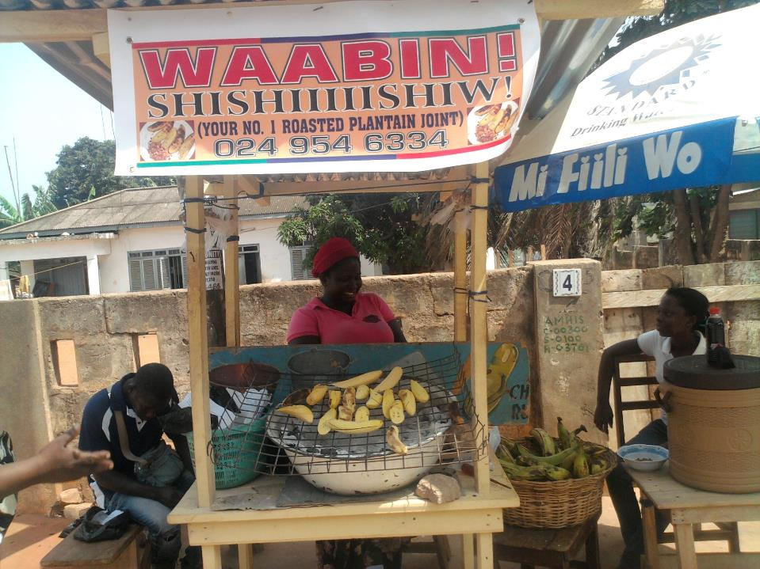


Slide 8
It’s about finding a wrong you want to right.

Slide 9
What is an Idea?
A mental impression or thought
Not all ideas can be converted into successful businesses
A successful idea is an opportunity

Slide 10
Sources of Business Ideas
Existing businesses
Franchises
Corporations
Customers
Competitors

Slide 11
Sources of Business Ideas
Distributors, wholesalers, retailers
Networking
Consulting
Former employees

Slide 12
Developing Successful Business
Opportunity recognition
Market assessment/feasibility analysis
Conducting industry analysis
Writing a business plan
Developing a business model

Slide 13
What is an Opportunity?
A favourable set of circumstances that creates a need for a new product, service, or business (Barringer & Ireland, 2008).
Anything that has value and is anchored in a product or service that adds value to the end user or buyer
Opportunities are created or built using ideas & entrepreneurial creativity

Slide 14
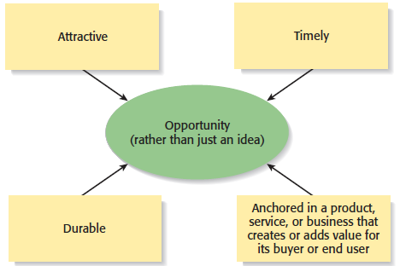
What is an Opportunity?
An opportunity has four essential qualities

Slide 15
Forces that Create Opportunity
Changing trends (SLEPT)
Chaos, confusion, incosistencies
Knowledge & information gaps
Other vacuum in an industry or market

Slide 16
Examples of How Changes in the Environment Provides Openings for
New Product and Service Opportunities
Structure of Population and Income | Number of teenagers higher than number of elderly and children | Cyber cafes, Cineplex's, recording studios
 | People have higher purchasing power | Passenger cars, household furniture, DVD
Social | Increase incident of housebreaking | Grills, alarm, sensor, security systems
 | Increase interest in fitness | Fitness center, dancing class, in-house exercise equipment, health food store
 | Increase mobility of population | Hand phone, laptop computers
 | Increasing predominance of dual-income families leaves less time to cook at home | Restaurants, food delivery services
Technological Advances | Advances in biotechnology | Biotech-related pharmaceutical products, foodproducts, veterinary products
 | Development of the internet | E-commerce, improved communication
 | Increase pressure to improve economicperformance | Online marketing, cost control services
Government Policies and Regulations | Increased driving standards | Smoke emission control, helmet, seatbelt

Slide 17
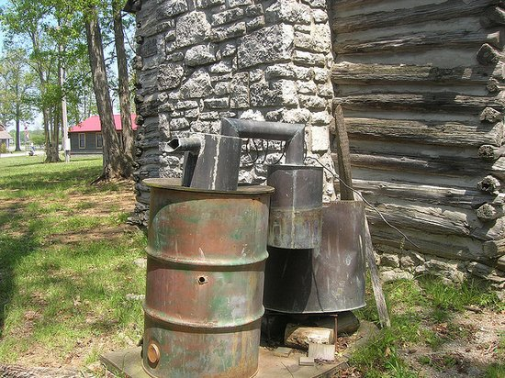
Whiskey

Slide 18
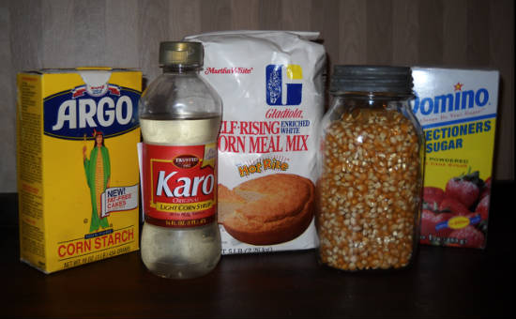

Slide 19
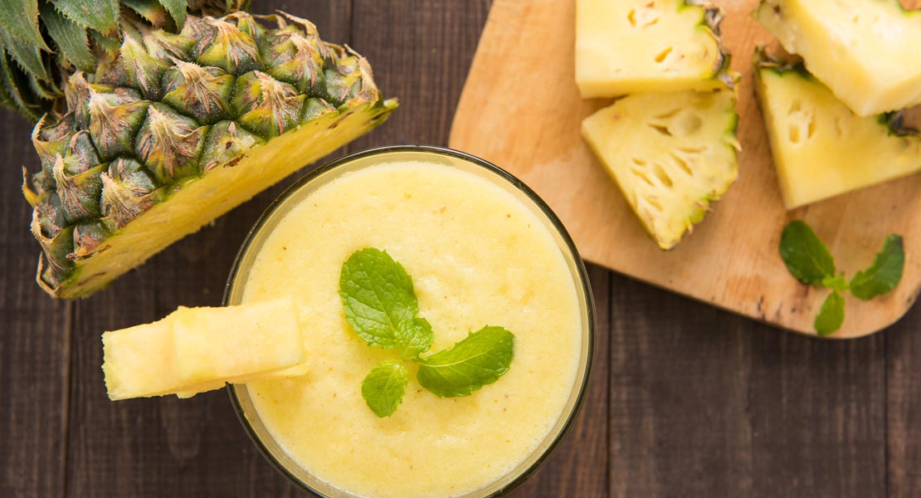
Pineapple

Slide 20
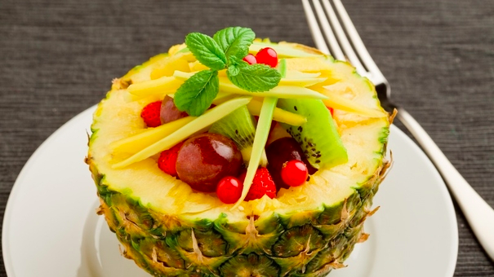

Slide 21


Slide 22
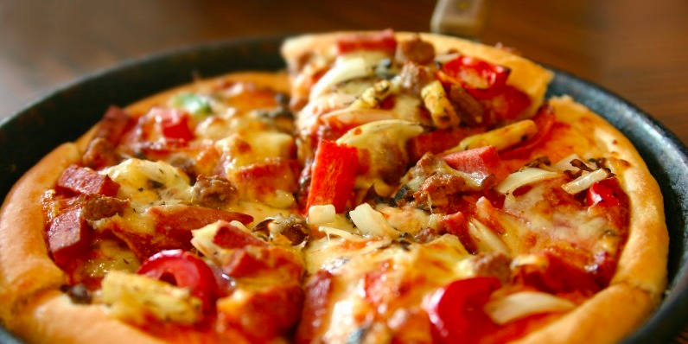

Slide 23
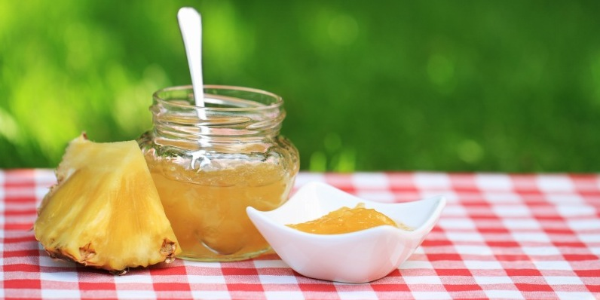

Slide 24
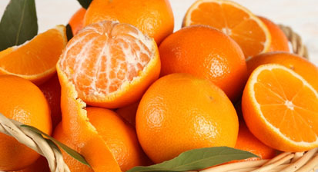
Citrus

Slide 25
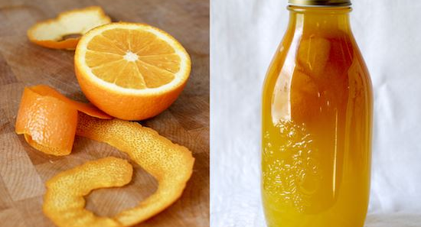

Slide 26
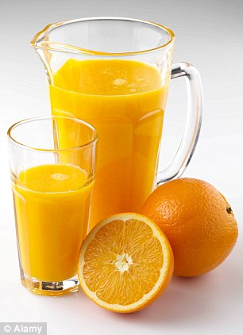

Slide 27
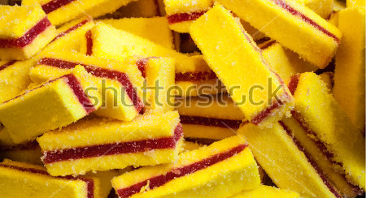

Slide 28
Brong Ahafo Region
Total population is 2,310,983
There are 21 districts
Arable farming is the predominant activity in the Region.
Cocoa, Timber, Cashew, Coffee, Rubber, Tobacco
The main staple crops grown are cassava, yaw, maize, plantain, rice, tomatoes and cocoyam
Cash crops grown are pineapple, citrus, vegetable and oil palm
Livestock and poultry production is relatively undeveloped in the Region
Poultry, pigs and small ruminants are raised at the domestic level

Slide 29
Famous native citizens of Brong-Ahafo - Citizen Settlement
Kevin-Prince Boateng - Sunyani
Asamoah Gyan – Wenchi
James Kwesi Appiah - Sunyani
Afriyie Acquah – Sunyani
Emmanuel Agyemang-Badu – Seikwa
John Paintsil – Berekum
Kwadwo Afari-Gyan – Berekum
Kofi Abrefa Busia - Wenchi

Slide 30
Value Chain Production
Producers / Cultivation
Conversion / Processing
Distribution

Slide 31
Cassava
Cooked fresh roots (that include pounded fresh cassava, locally know as fufu in Ghana)
Cassava flours: fermented and unfermented (pie, pastries, bread etc)
Granulated roasted cassava (gari)
Granulated cooked cassava (attieke, kwosai)
Fermented pastes (agbelima, fufu in Nigeria)
Sedimented starches
Drinks (with cassava components)
Leaves (cooked as vegetables)
Medicines
Chips

Slide 32
Maize
Maize flour, or meal, is made into a thick porridge in many cultures
Cornstarch is made from maize kernels
Corn syrup is used as a sweetener instead of sugar
Corn for cows, hogs, catfish and chickens
Maize oil
Popcorn
Penicillin – corn steep liquor
Whiskey
Sweet corn
Animal feed

Slide 33
Errors in selection
“Me too” syndrome
Fallacy of numbers
“Story of an elephant” syndrome
Square peg in a round hole
Undifferentiated enterprise
Failure to grasp key elements of success
Lack ownership
Catch the first bus
Inaccurate information
Unwillingness to step back

Slide 34
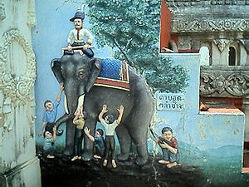

Slide 35
The blind man who feels a leg says the elephant is like a pillar the one who feels the tail says the elephant is like a rope the one who feels the trunk says the elephant is like a tree branch the one who feels the ear says the elephant is like a hand fan the one who feels the belly says the elephant is like a wall and the one who feels the tusk says the elephant is like a solid pipe.

Slide 36
Window of Opportunity
The time period in which a firm can realistically enter a new market
To capitalise on an opportunity, its window of opportunity must be open

Slide 37
Window of Opportunity
The window opens when the market is established & is profitable
It closes when the market matures & profitability dwindles to make it less attractive for new entrants

Slide 38
The Strategic Window
Spotting the window
Determining the size of the window
Opening the window
Moving through the window
Closing the window

Slide 39
Spotting the Window
Creative flash
Eureka
Personal analysis
Organisational analysis

Slide 40
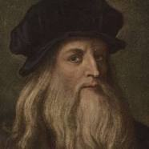
Leonardo da Vinci
Leonardo da Vinci conceptualized the submarine, and it is possible (probable) that others could have thought of the idea of an undersea vehicle, but the technology to put a working model in the water and safely and effectively operate it didn't come along for over a century following Leonardo.

Slide 41
Spotting Opportunities: Success Factors
Know your market
Keep an open mind
Concentrate on the customer‘s needs - not technical capabilities

Slide 42
Determining the Size of the Window
How big the opportunity is depends on
Market size/market potential
Share attainable/sales potential
Market growth rate
Share sustainable

Slide 43
Determining the Size of the Window
Investment necessary to maintain position
Likely returns
Stability of returns
Sustainability of competitive advantage

Slide 44
Opening the Window
Securing the required initial cash investment
Setting up the organisation
Attracting key stakeholders
Entering the network
Taking personal initiatives

Slide 45
Moving through the Window
Sustaining demand
Maintaining investment
Managing cashflow
Developing the organisation
Managing role changes

Slide 46
Closing the Window
Entrenching competitive position
Continuing innovation
Sustaining the organisation
Maintaining networks
Ensuring appropriate stakeholder rewards

